Slide 1
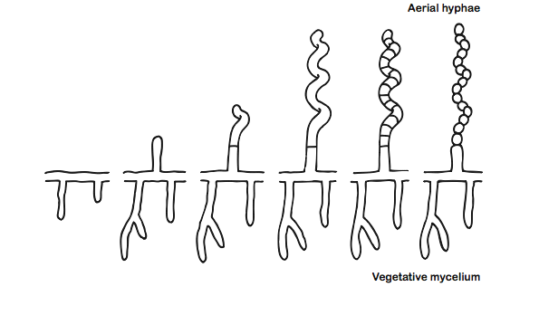
Sporulation in Streptomyces

Slide 2
whiH mutants are defective in septation
Colony appearance
Sporulating aerial hyphae
WT
whiH⁻
WT
whiH⁻

Slide 3
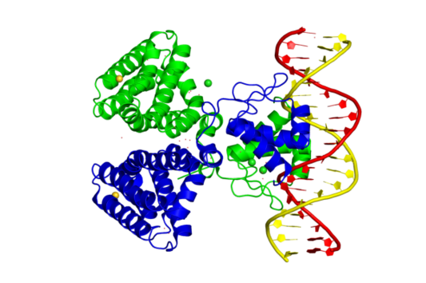
WhiH is a FadR-like transcription factor
E. coli FadR dimer bound to DNA
www.ebi.ac.uk/pdbe-srv/view/entry/1h9t/summary

Slide 4
What does WhiH regulate?
Bush, Tschowri, Schlimpert, Flärdh, and Buttner (2015) Nature Rev. Microbiol. 13:749

Slide 5
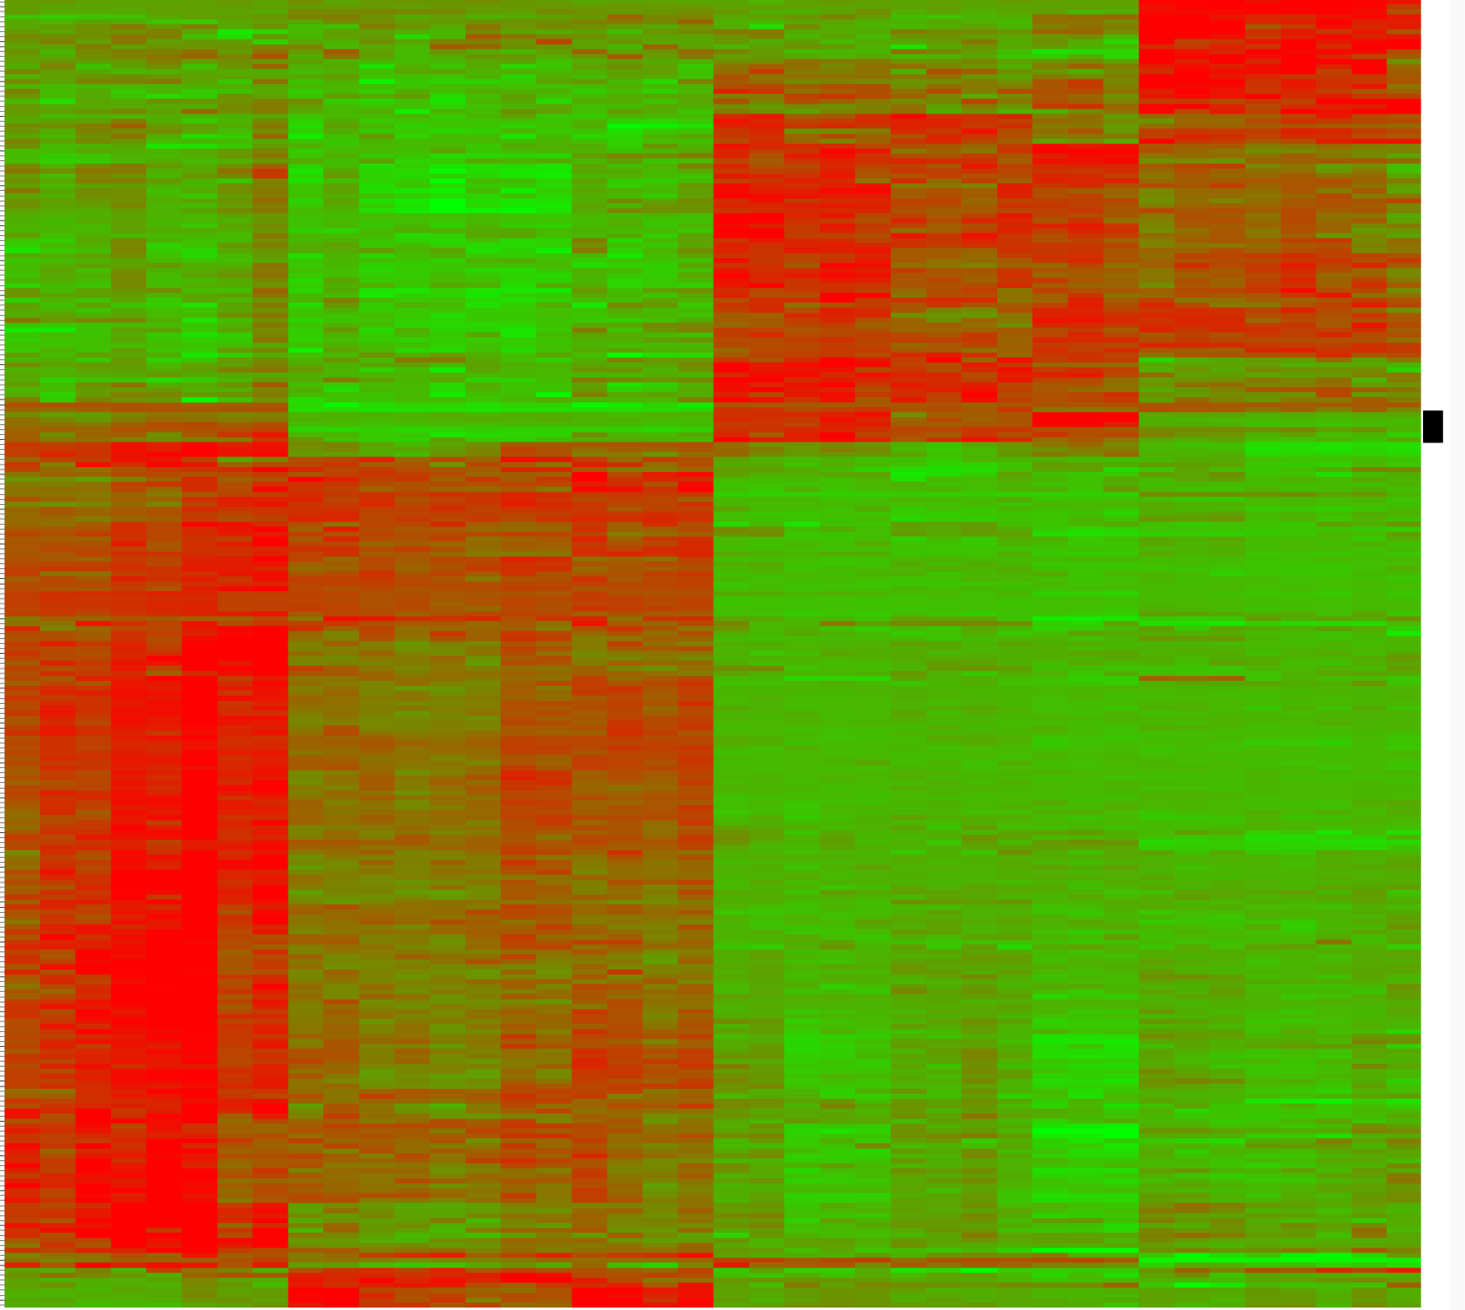
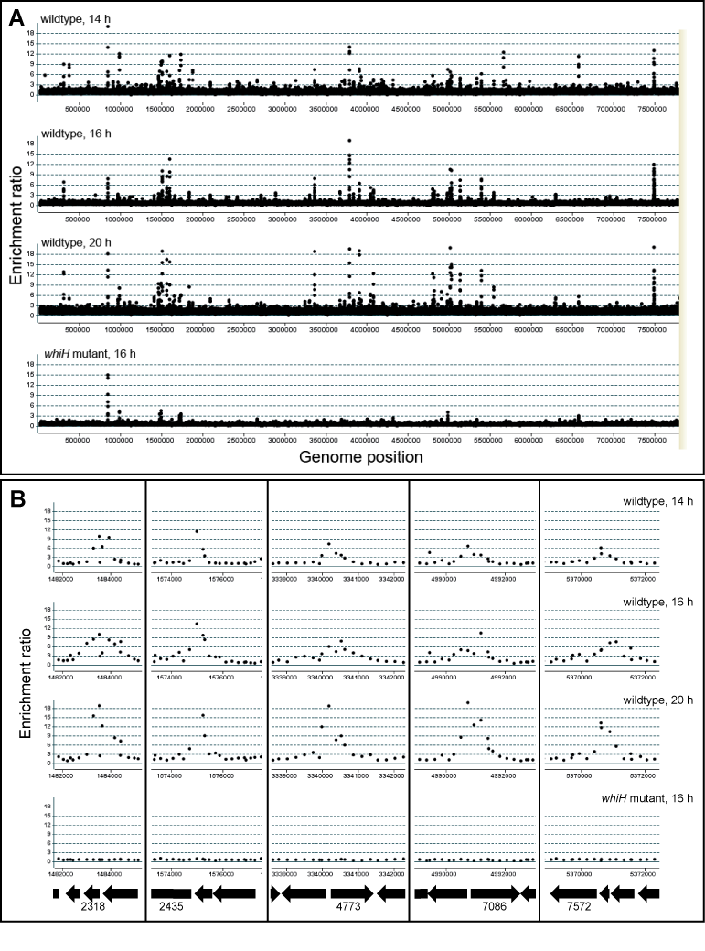
Mapping the WhiH regulon
Microarray transcriptomics
ChIP-chip
Wildtype
16-20h
whiH
16-20h
whiI
16-20h
whiG
16-20h

Slide 6
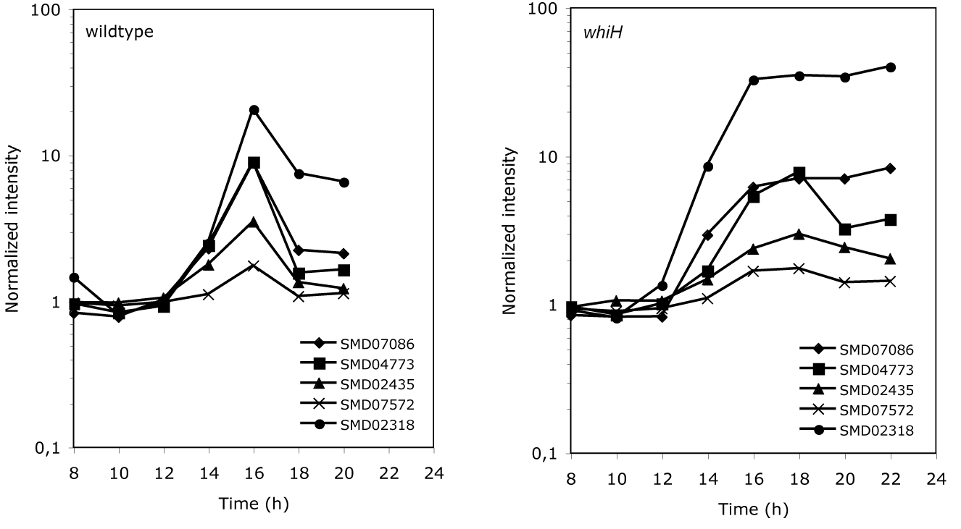
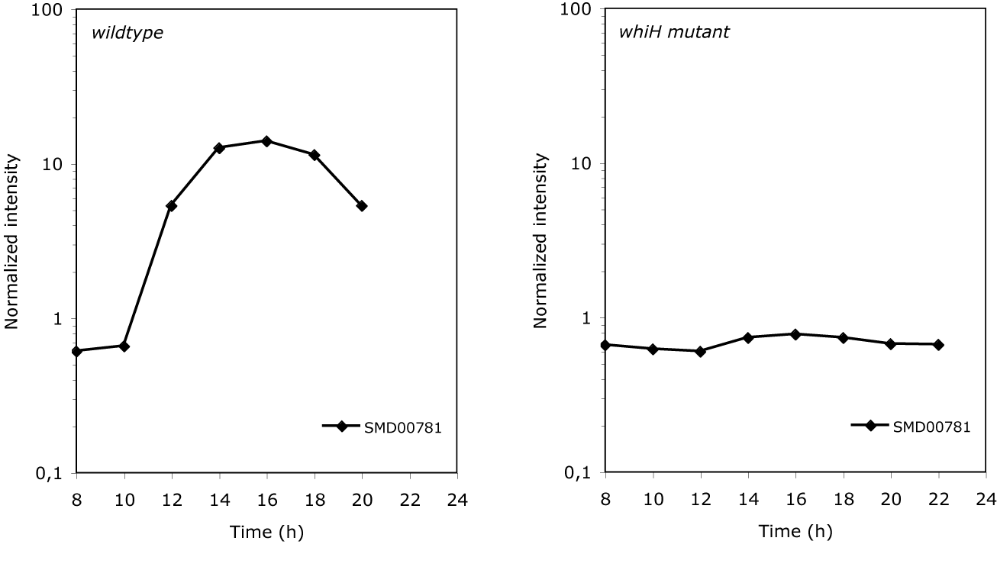
Expression pattern of WhiH-repressed target genes
Expression pattern of WhiH-activated target gene
wt
whiH

Slide 7
Putative WhiH-repressed genes
- WhiH 1190 595 238 190 167 143 119 95 71 48 24 5 0,5 nM
SMD07086
WhiH (228 nM)
-
+
+
+
+
cold probe
-
-
500x
100x
20x

Slide 8
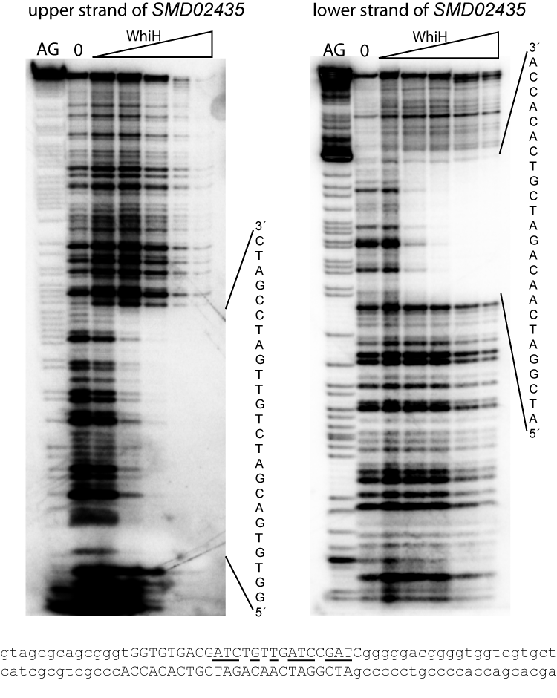
WhiH binding to promoters
DNaseI footprinting
Electrophoretic mobility shift assay
0 1190 595 238 190 167 143 119 95 71 48 24 5 0,5 nM
SMD07086
Elisabeth Barane and Jessica Persson

Slide 9
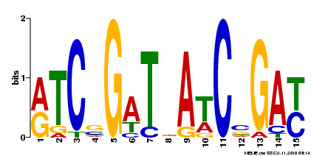
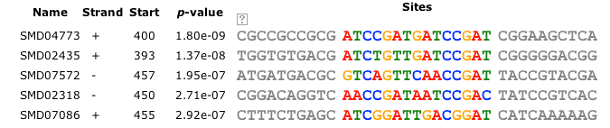
Common motif in promoters of repressed genes
Notes:
9

Slide 10
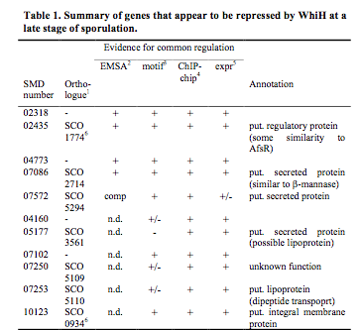
+
-
+
+
+
+

Slide 11
The WhiH regulon in S. venezuelae
WhiH
dynA dynB
Cell division
FtsZ ring assembly
geoA
Geosmin synthesis
Sven5429-32
Glutamate transport?
10 other loci are repressed by WhiH late in sporulation
whiH

Slide 12
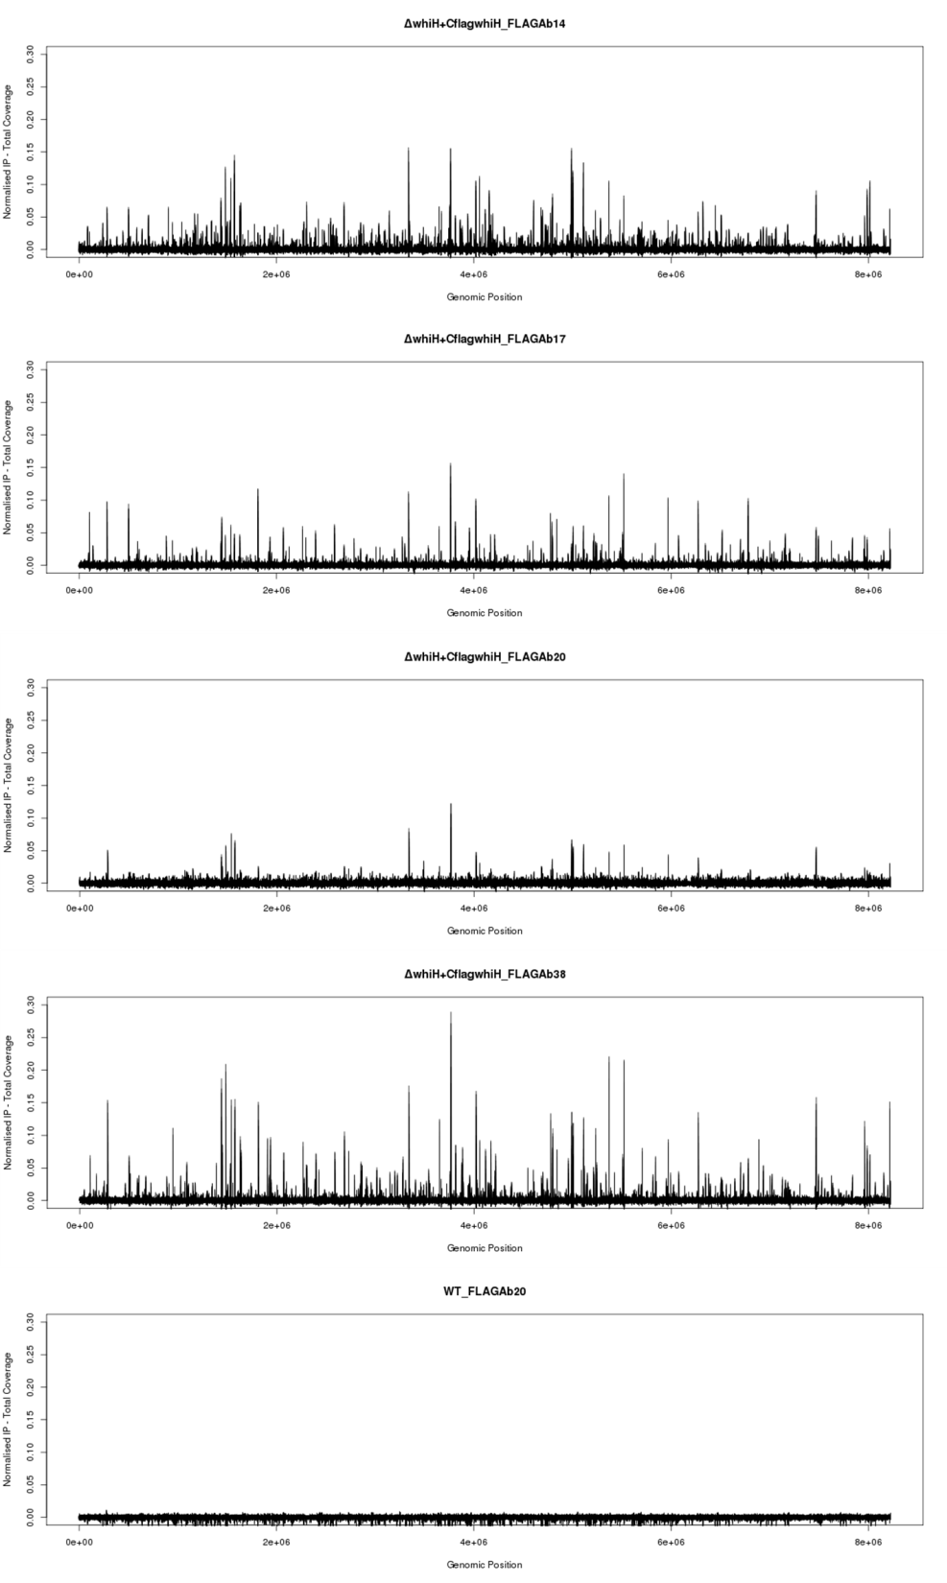
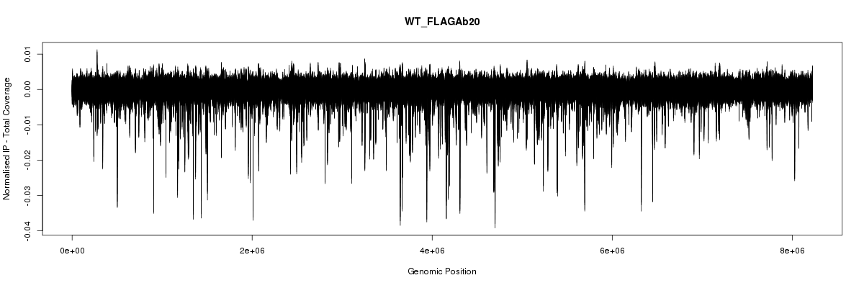
14hr
WhiH-FLAG ChIP-seq
17hr
20hr
38hr
“Negative regions of enrichment”
-ve 20hr

Slide 13
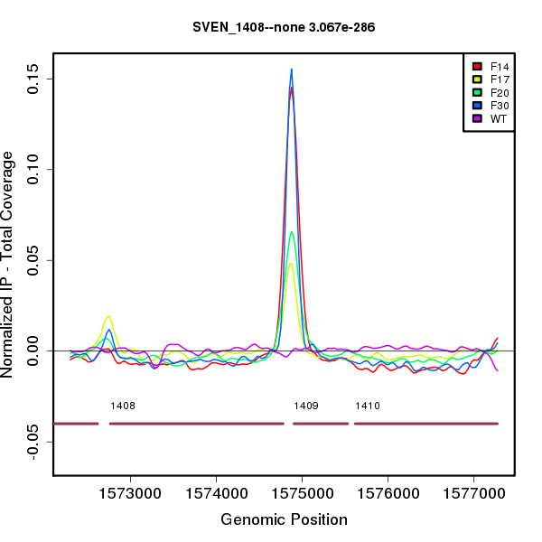
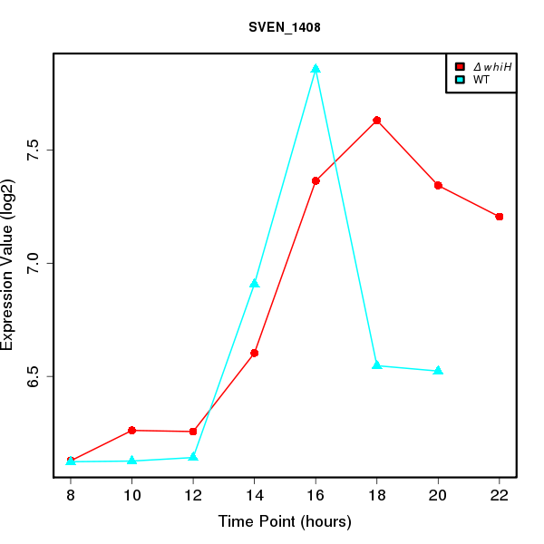
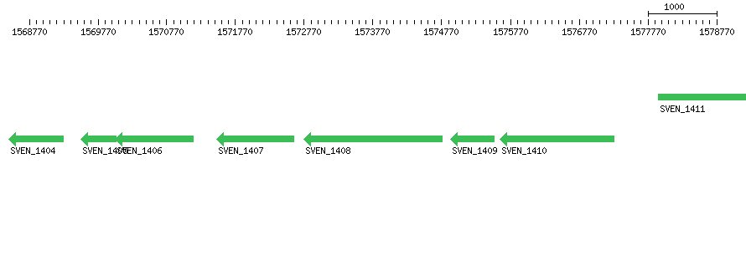
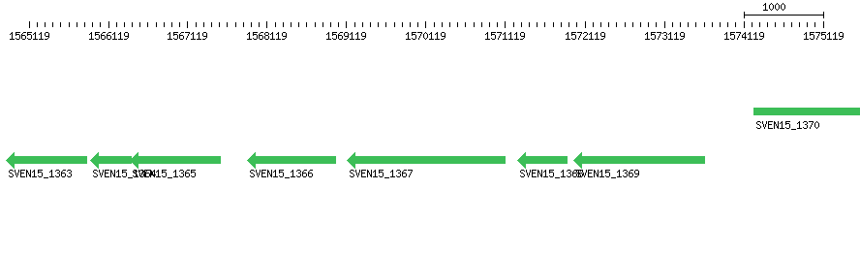
SMD02435

Slide 14
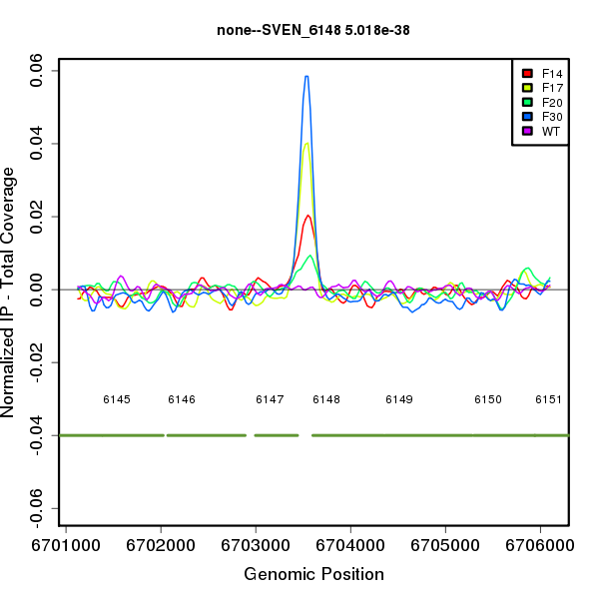
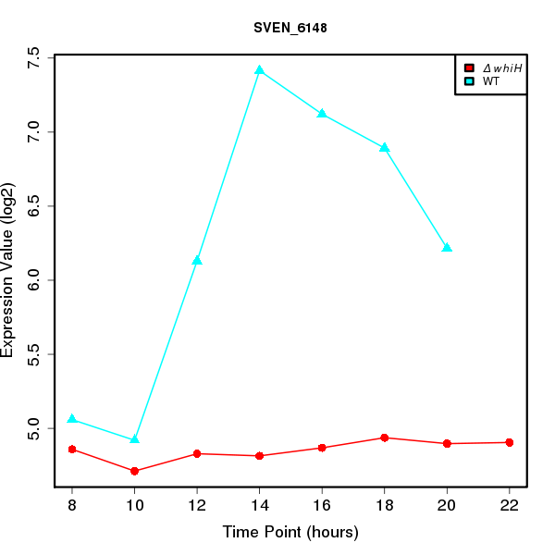
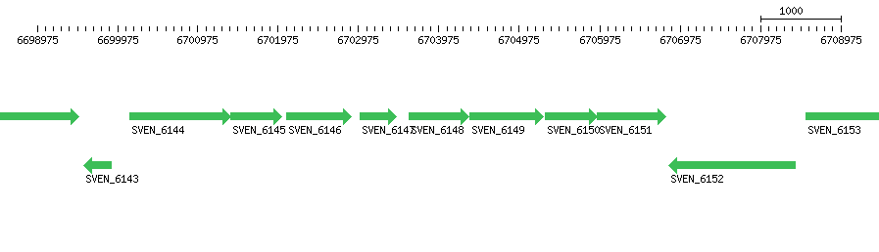
Sven_6148
put. ammonium uptake system

